Slide 1
See if G and P negative selection sites are in the binding sites.

Slide 2
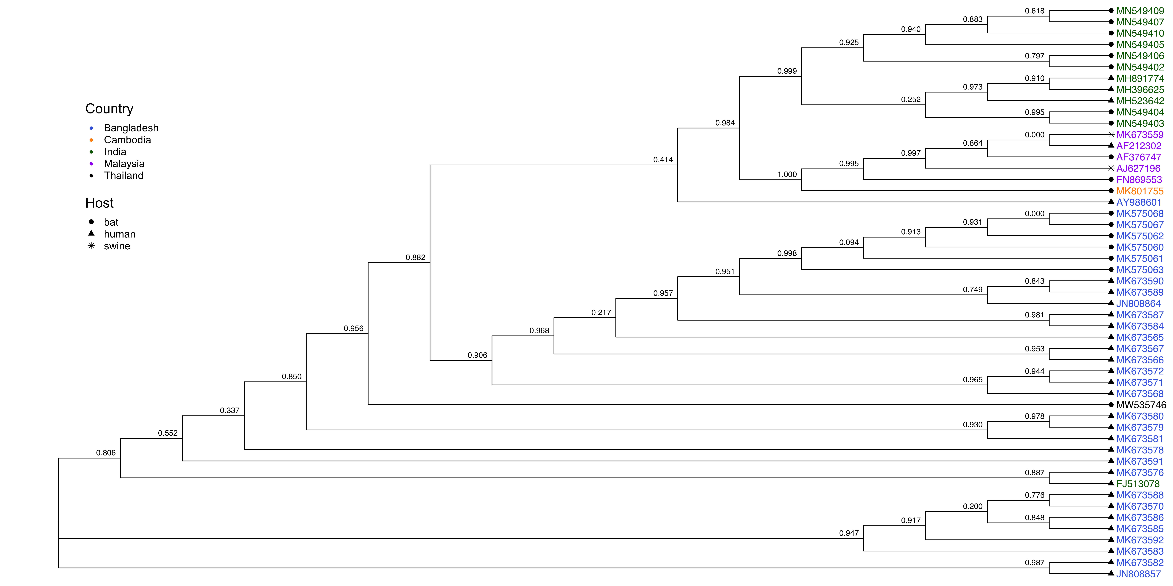
NiV Phosphoprotein, Unique Sequences
Notes:
MK575063 has a premature stop codon.

Slide 3
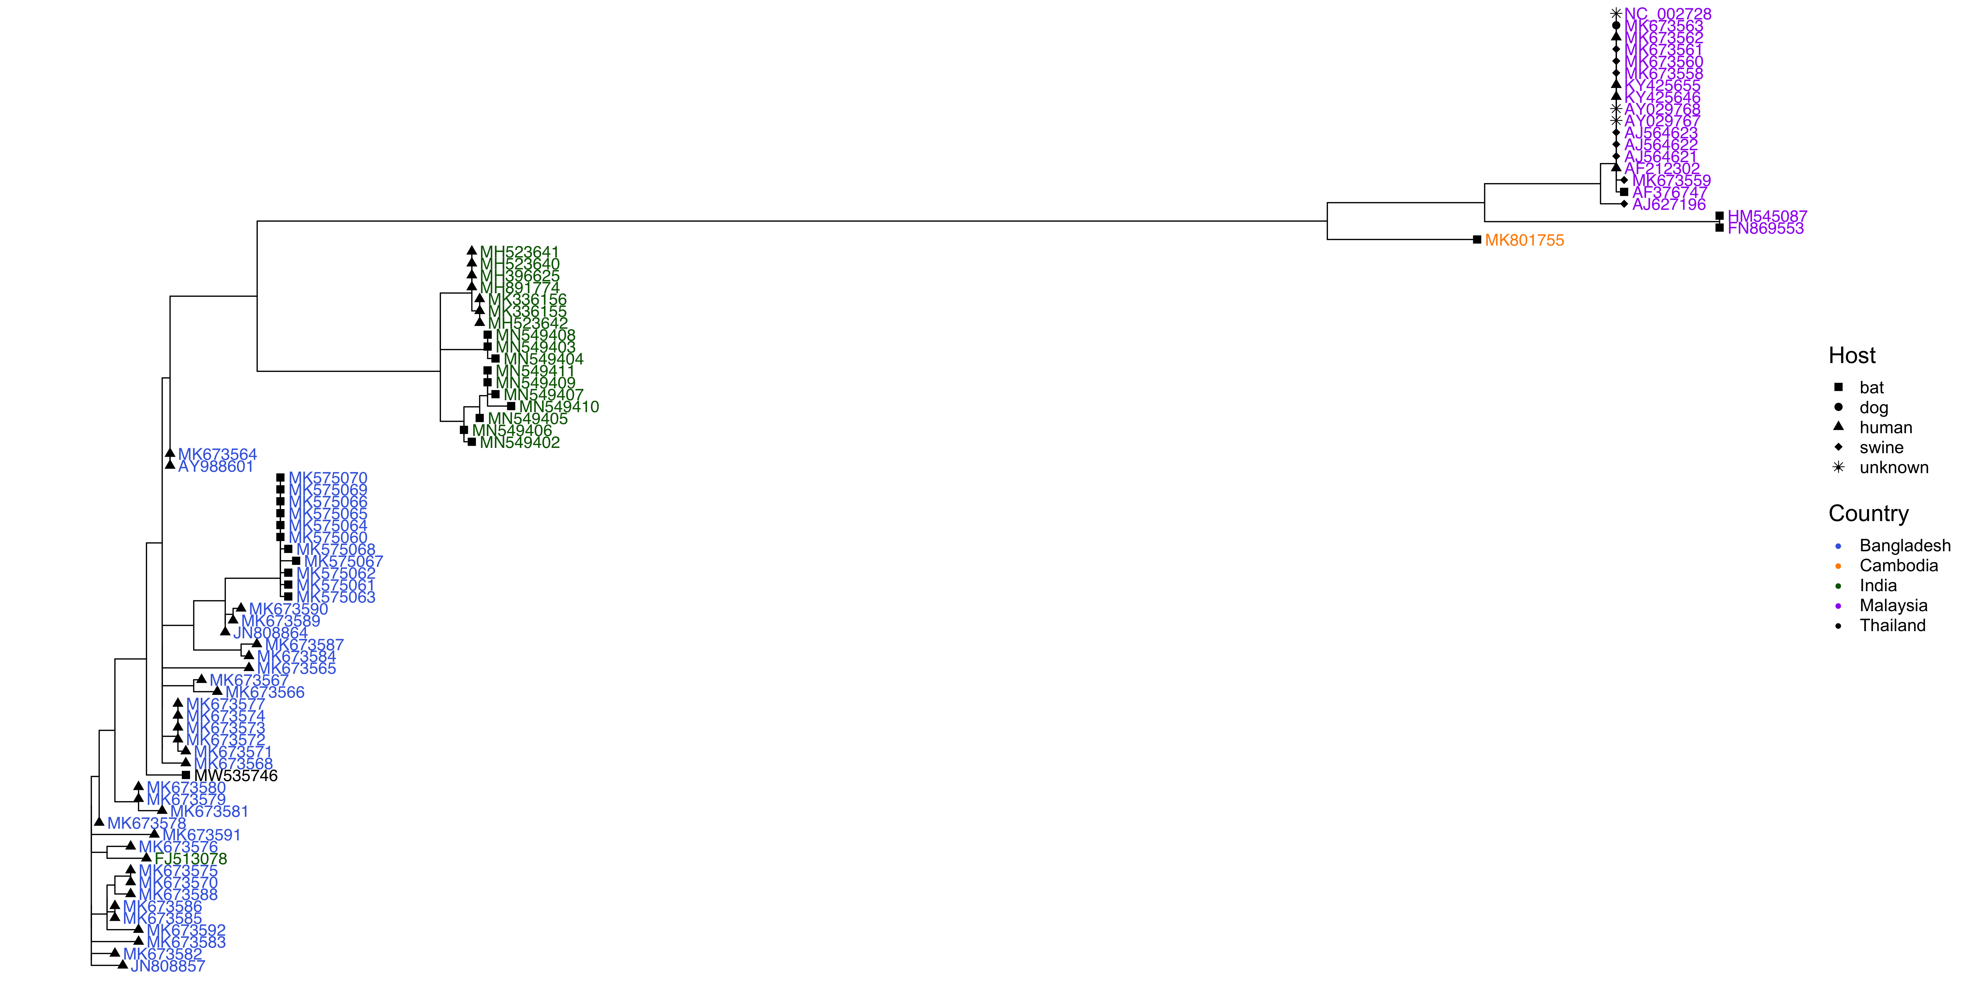
NiV Phosphoprotein, All Sequences
Notes:
Ask about how best to represent this? Also surprising that branch lengths are greater for Malaysian strain than Bangladeshi? M is older than B, but is this just because of how the model assigns a “reference?” Need to put in dates to get M earlier than B probably.

Slide 4
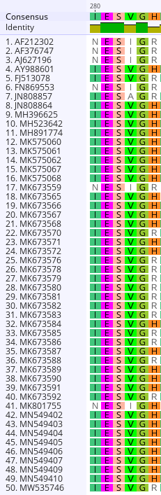
Sites under positive selection in phosphoprotein (FUBAR)
285
380
421
Notes:
FUBAR maybe better at detecting very weak positive selection.

Slide 5
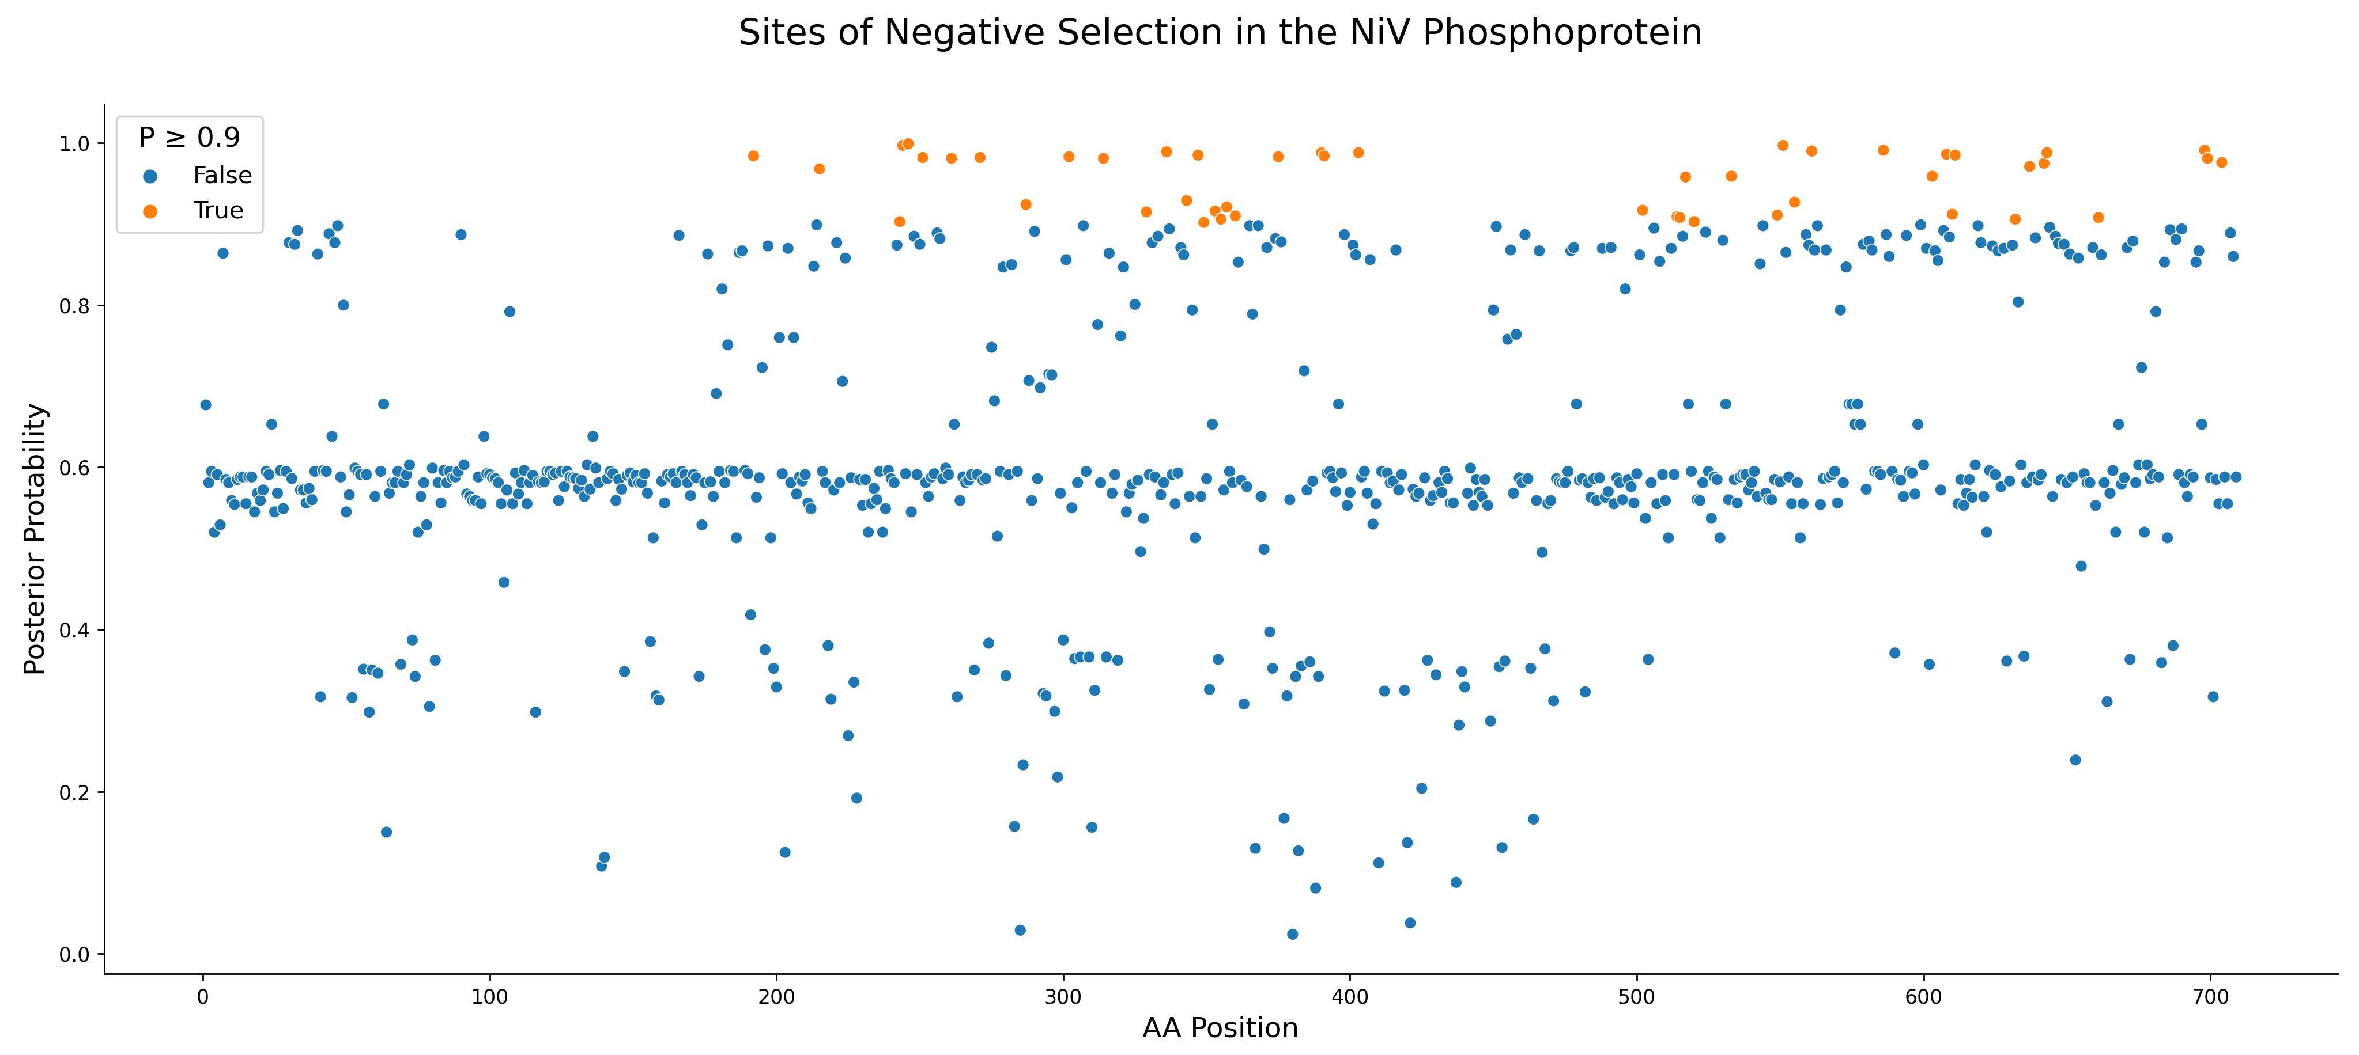
Notes:
Exact sites: 192-403, 502-704

Slide 6
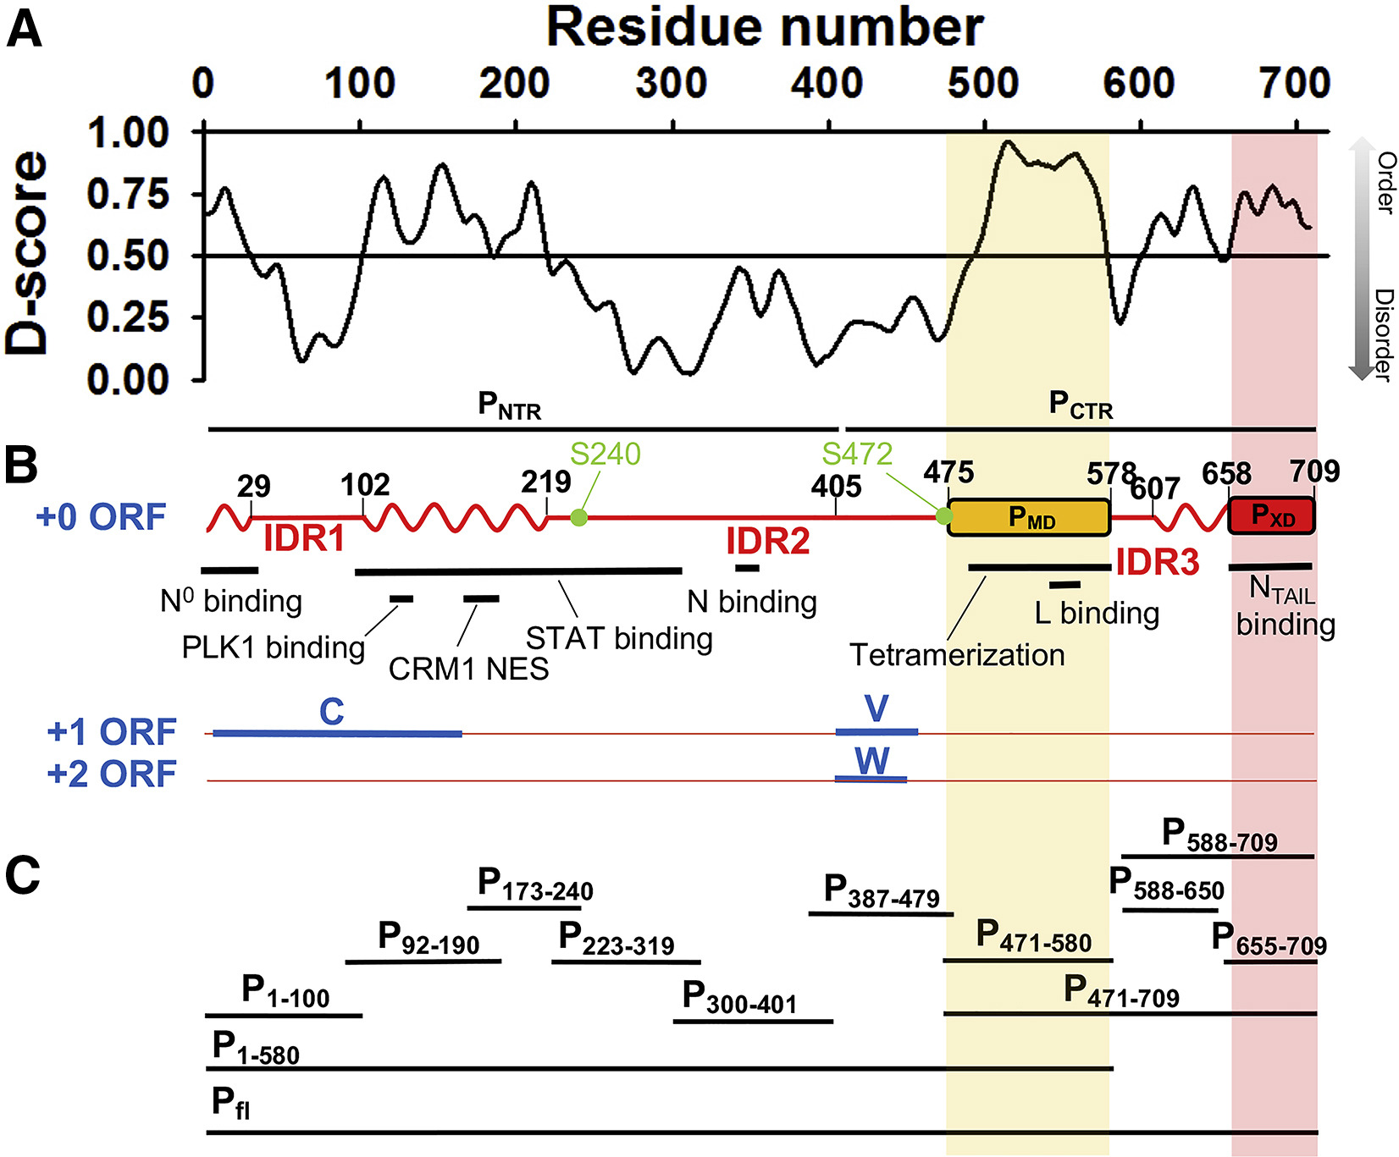
Jensen et al., Biophysical Journal, 2020
Notes:
Exact sites: 192-403, 502-704

Slide 7
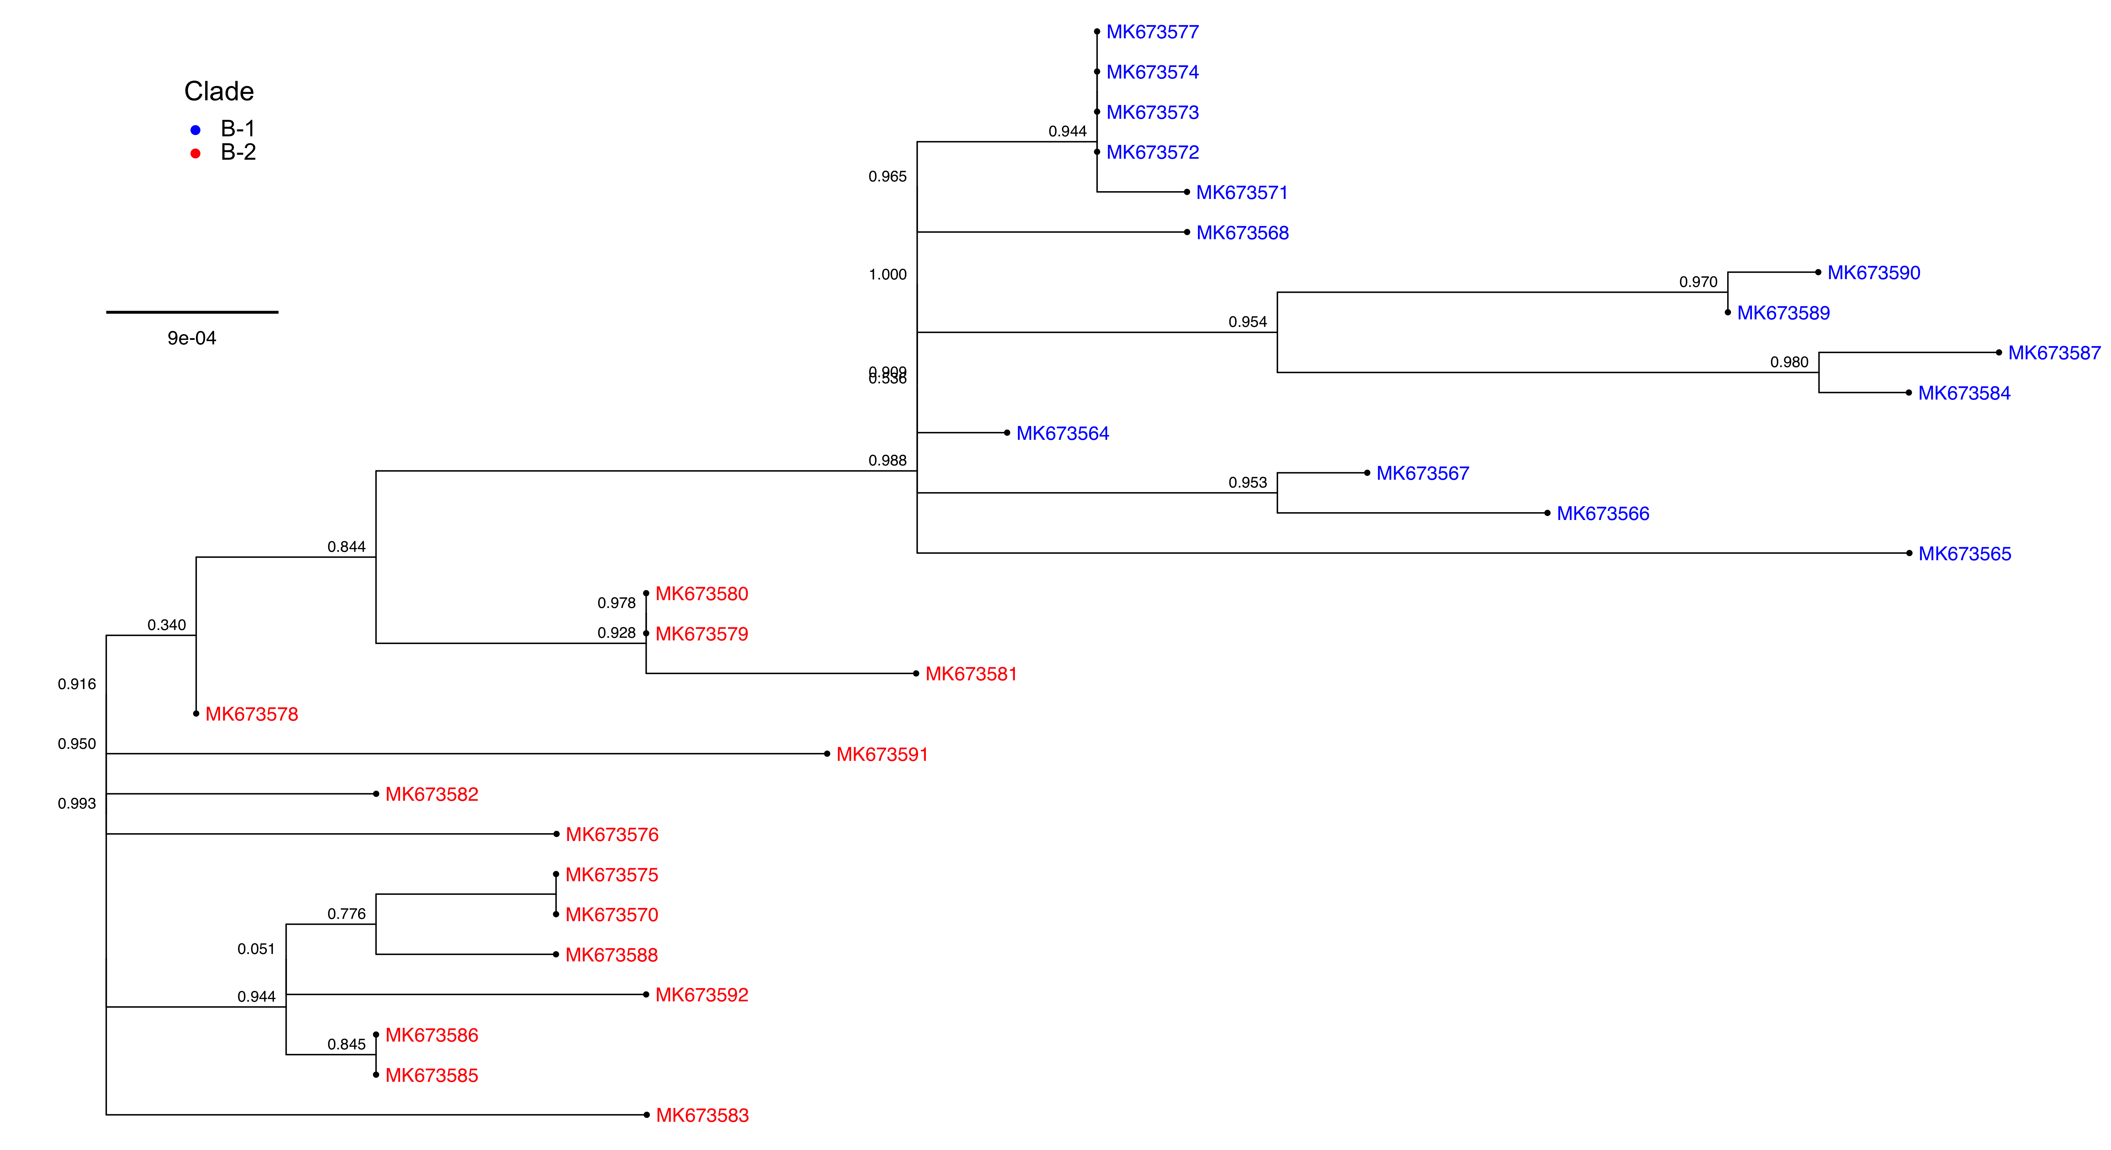
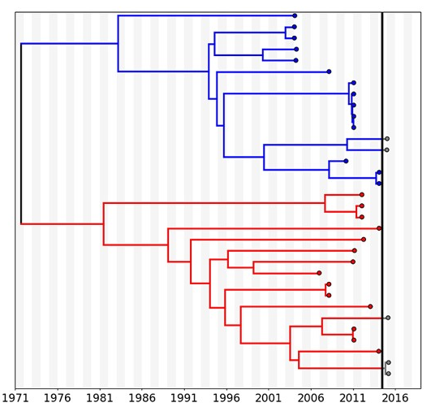
NiV Phosphoprotein Tree by Bangladesh Clades
Whitmer et al., Virus Evolution, 2021
Notes:
Clade or sublineage?

Slide 8
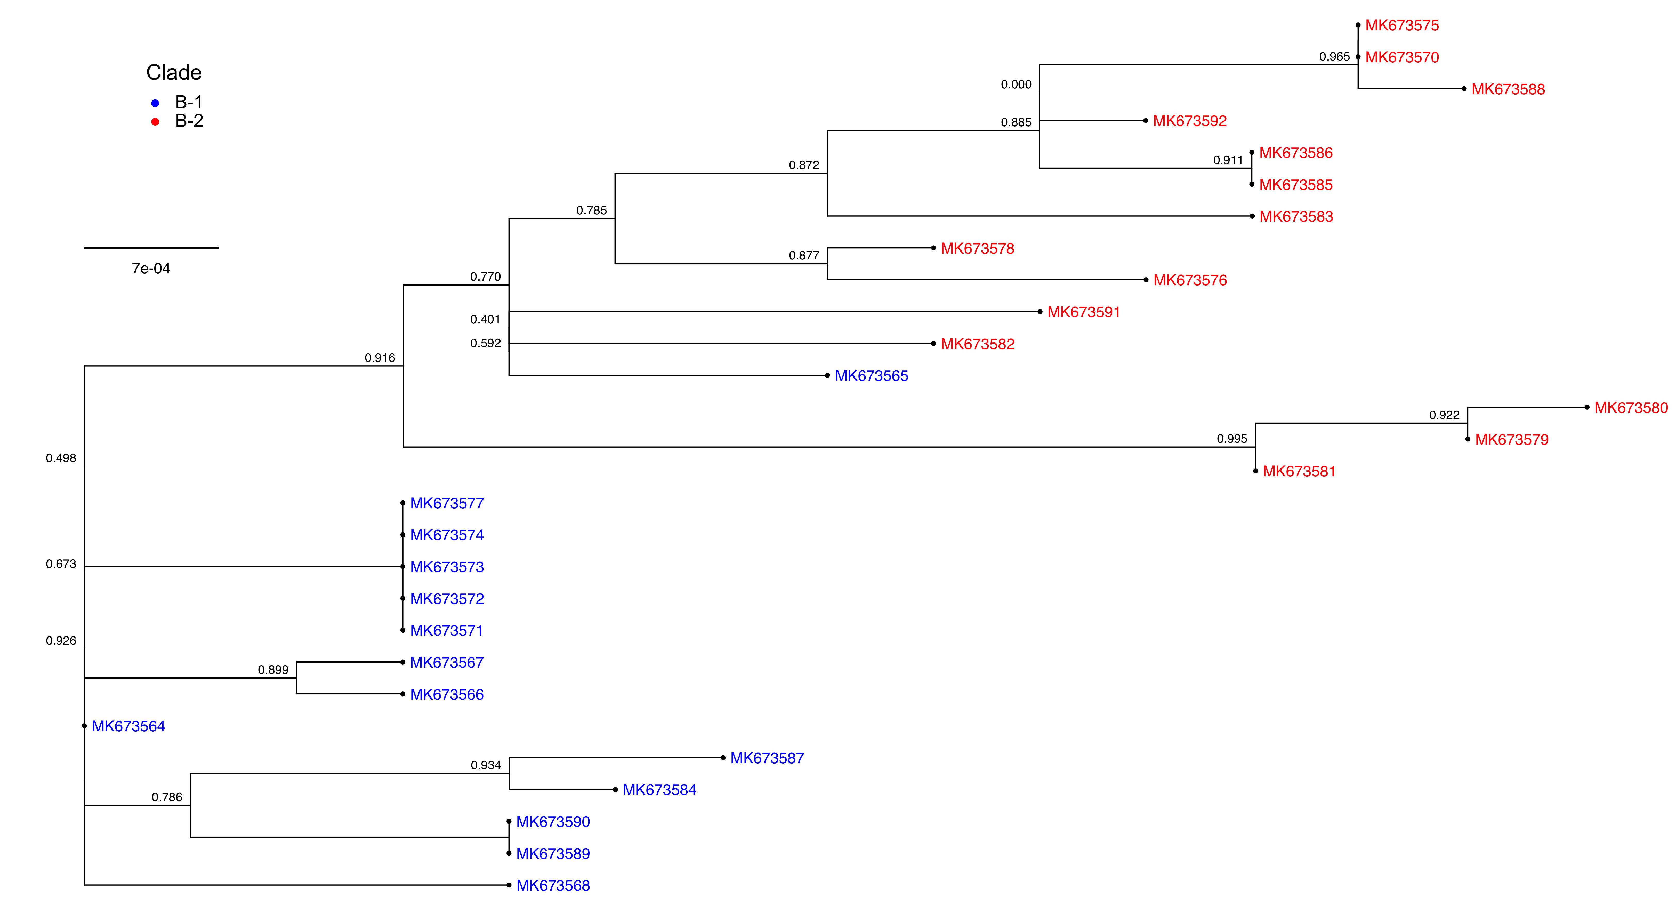
NiV Glycoprotein Tree by Bangladesh Clades
Whitmer et al., Virus Evolution, 2021

Slide 9
